Slide 1
Polymer Drug Conjugates

Slide 3
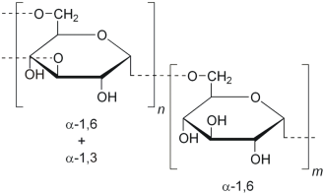
Natural polymers: 1) Dextran: Dextran is a complex, branched glucan (polysaccharide made of many glucose molecules) composed of chains of varying lengths (from 3 to 2000 kilodaltons)

Slide 6
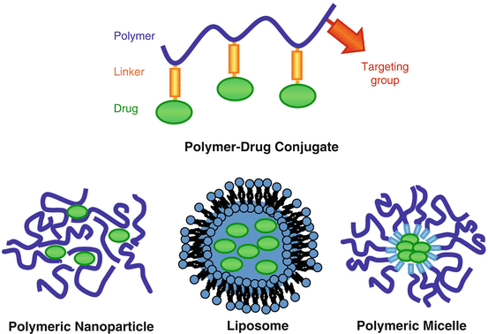

Slide 8
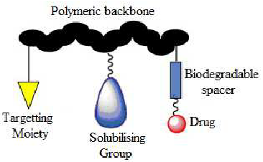

Slide 9
